Slide 1
Linear Algebra
线性代数
Zongbin Chen YMSC, Tsinghua University
陈宗彬 清华大学数学科学中心
Email: zbchen@tsinghua.edu.can

Slide 2


Quick review
Three equivalent problems

Slide 3
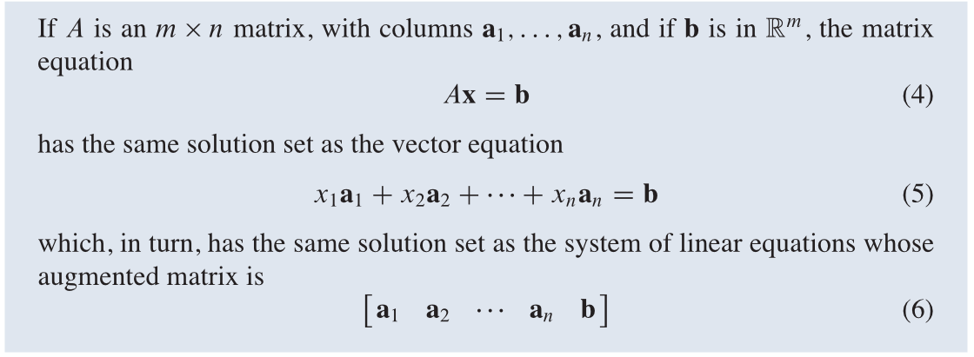

Theorem: The above three equations has the same set of solution. More precisely,

Slide 4
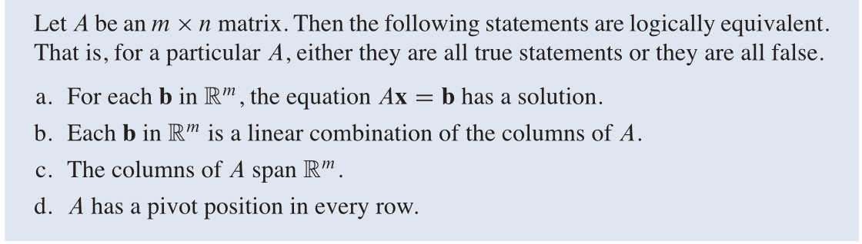
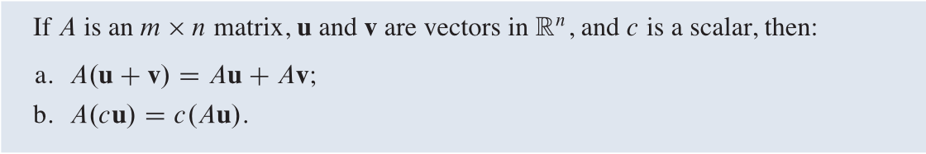
A criteria
Property of matrix-vector product

Slide 5
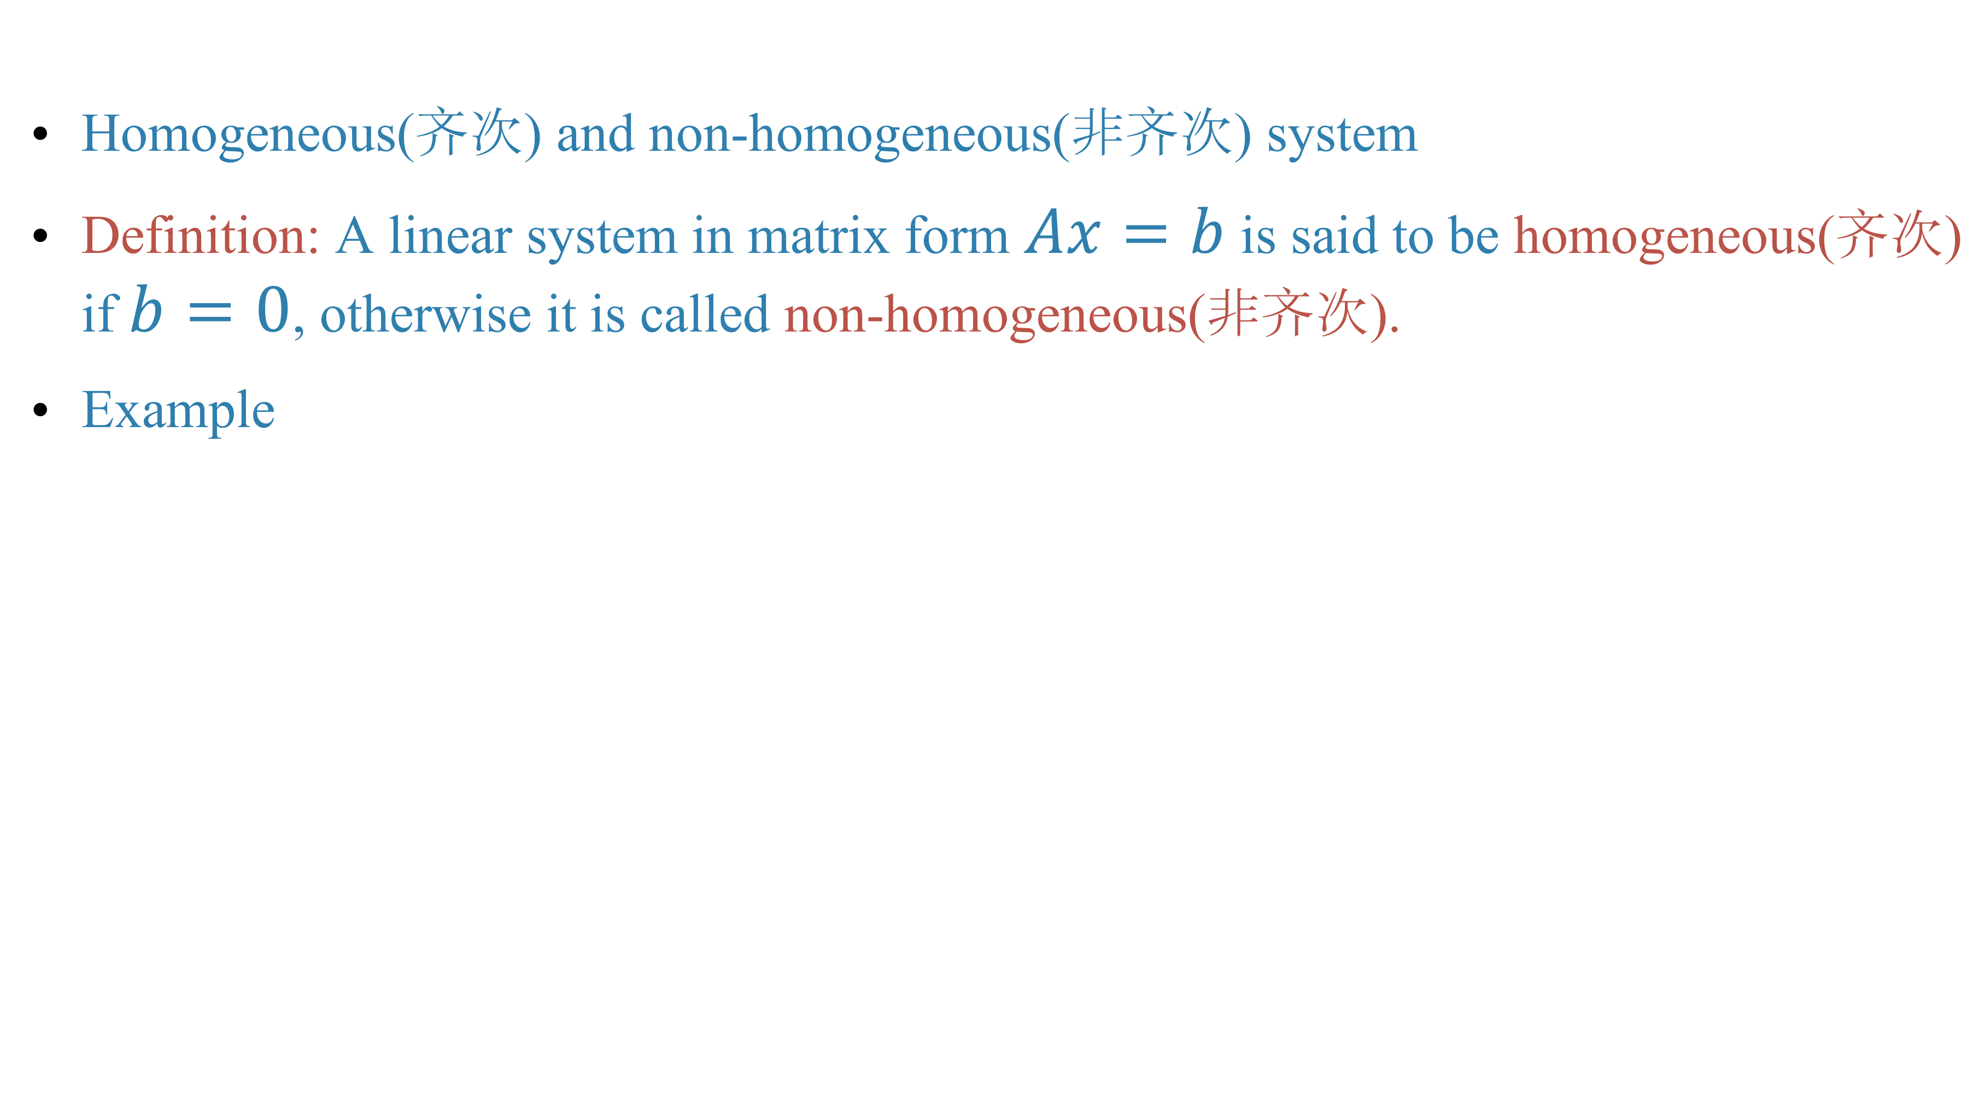
Homogeneous(齐次) and non-homogeneous(非齐次) system
Definition: A linear system in matrix form $Ax=b$ is said to be homogeneous(齐次) if $b=0$, otherwise it is called non-homogeneous(非齐次).
Example

Slide 6
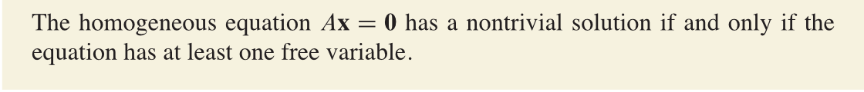
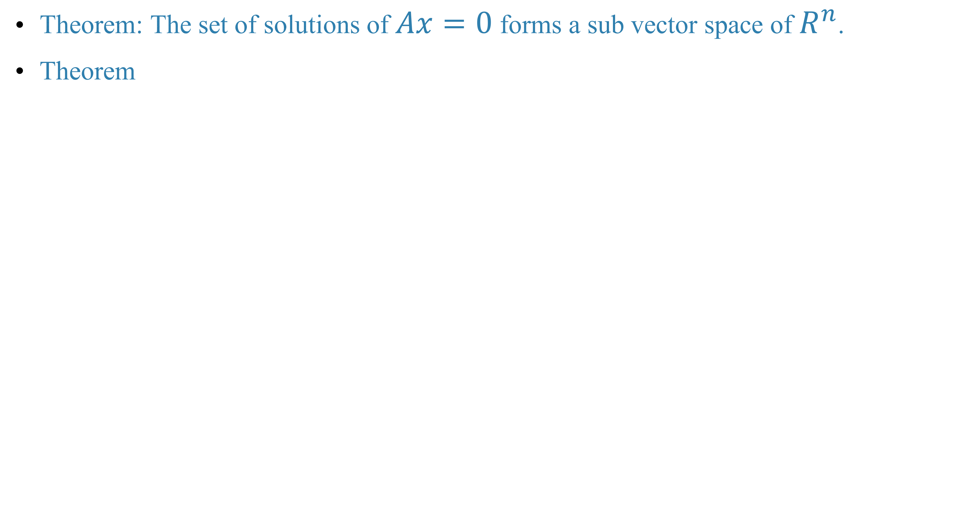
Theorem: The set of solutions of $Ax=0$ forms a sub vector space of $R^{n}$.
Theorem

Slide 7
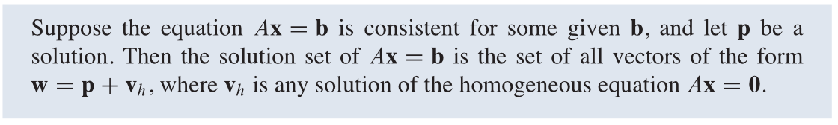
Solutions of non-homogeneous system
Theorem

Slide 8
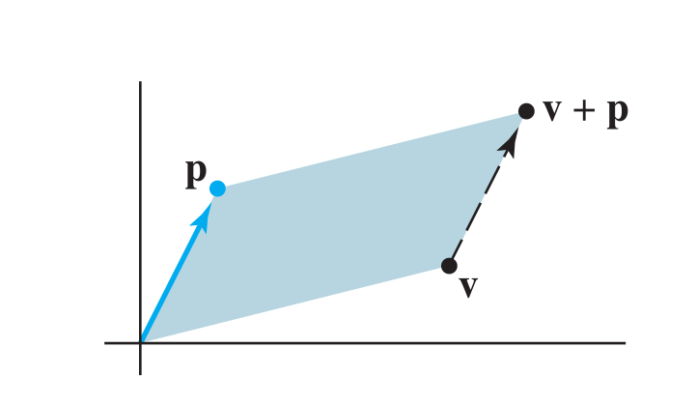
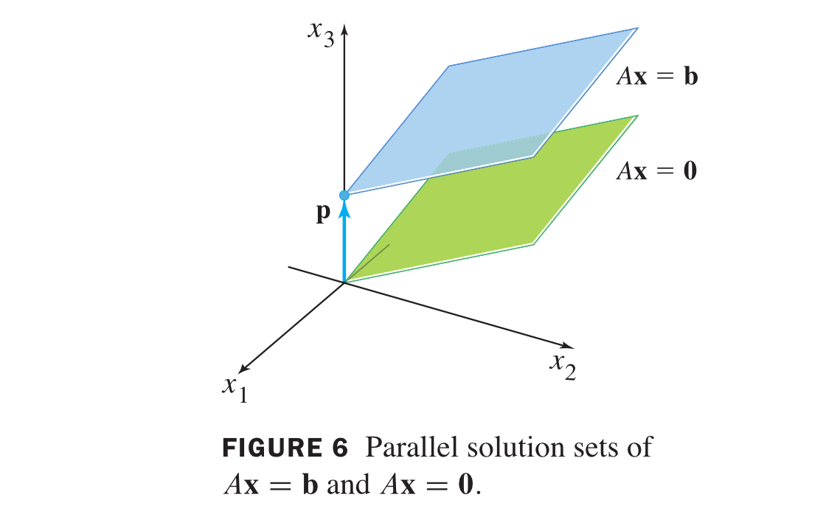
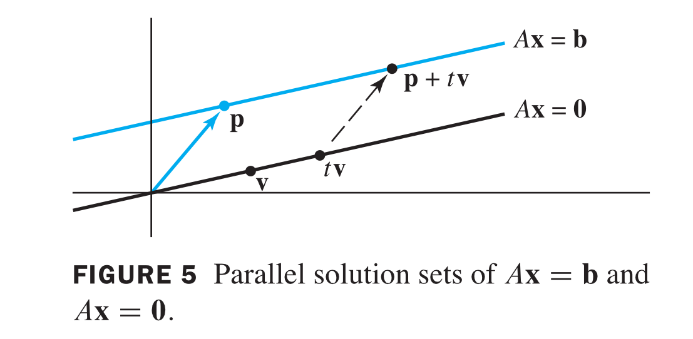
Geometric meaning

Slide 9
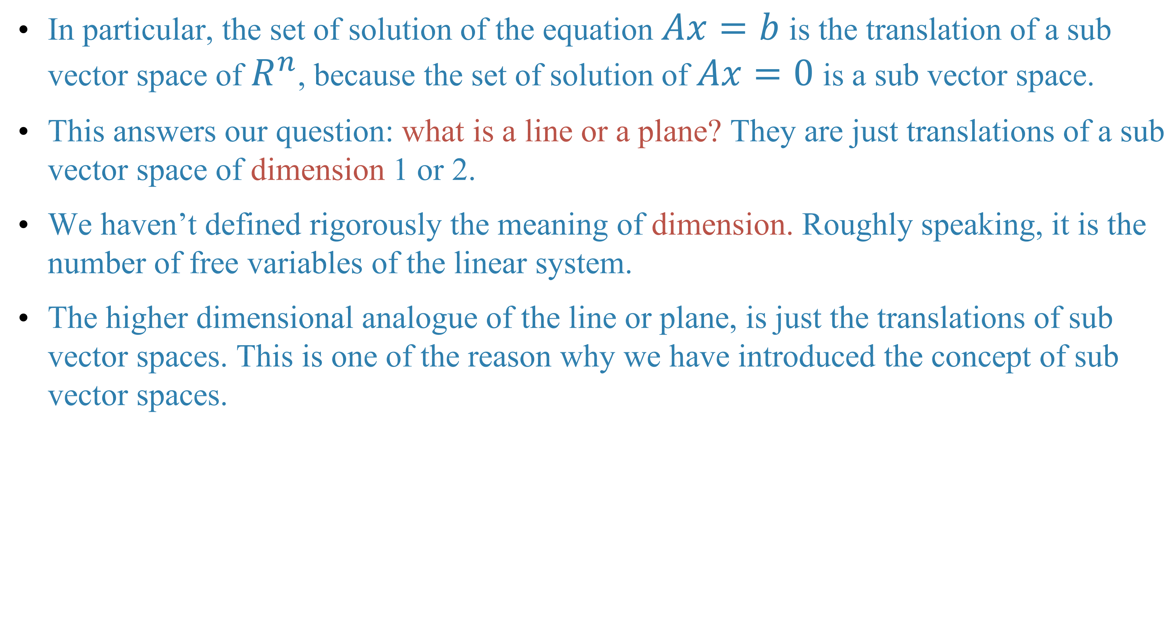
In particular, the set of solution of the equation $Ax=b$ is the translation of a sub vector space of $R^{n}$, because the set of solution of $Ax=0$ is a sub vector space.
This answers our question: what is a line or a plane? They are just translations of a sub vector space of dimension 1 or 2.
We haven’t defined rigorously the meaning of dimension. Roughly speaking, it is the number of free variables of the linear system.
The higher dimensional analogue of the line or plane, is just the translations of sub vector spaces. This is one of the reason why we have introduced the concept of sub vector spaces.

Slide 10
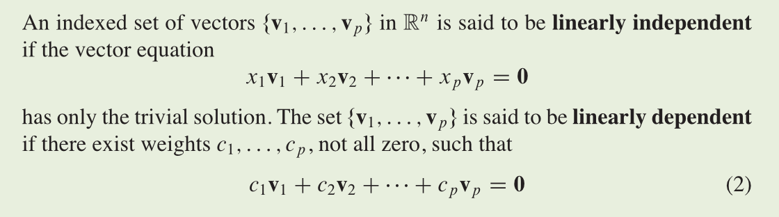
Linear independence of vectors
Definition: linear independent(线性无关), linear dependent(线性相关)

Slide 11
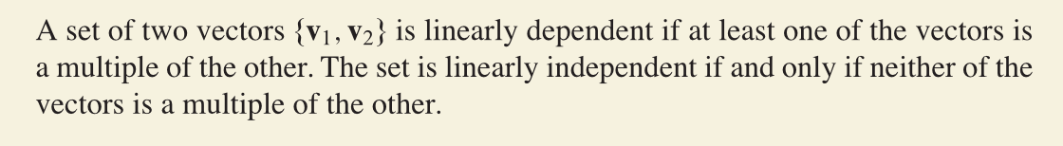
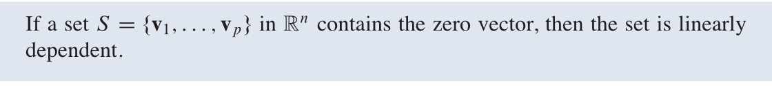
Example
Example

Slide 12
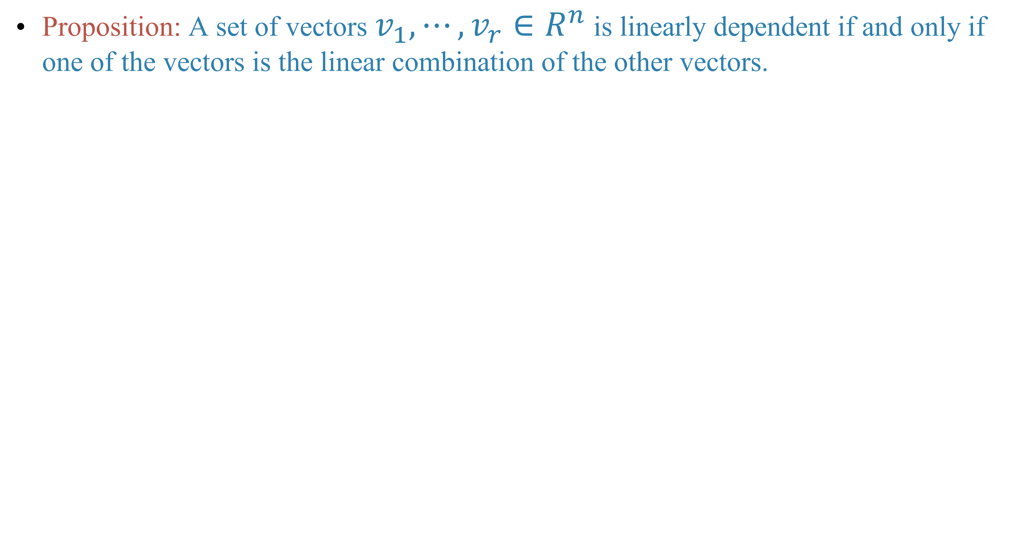
Proposition: A set of vectors $v_{1},⋯,v_{r}∈R^{n}$ is linearly dependent if and only if one of the vectors is the linear combination of the other vectors.

Slide 14
Relations with homogeneous linear system

Slide 15
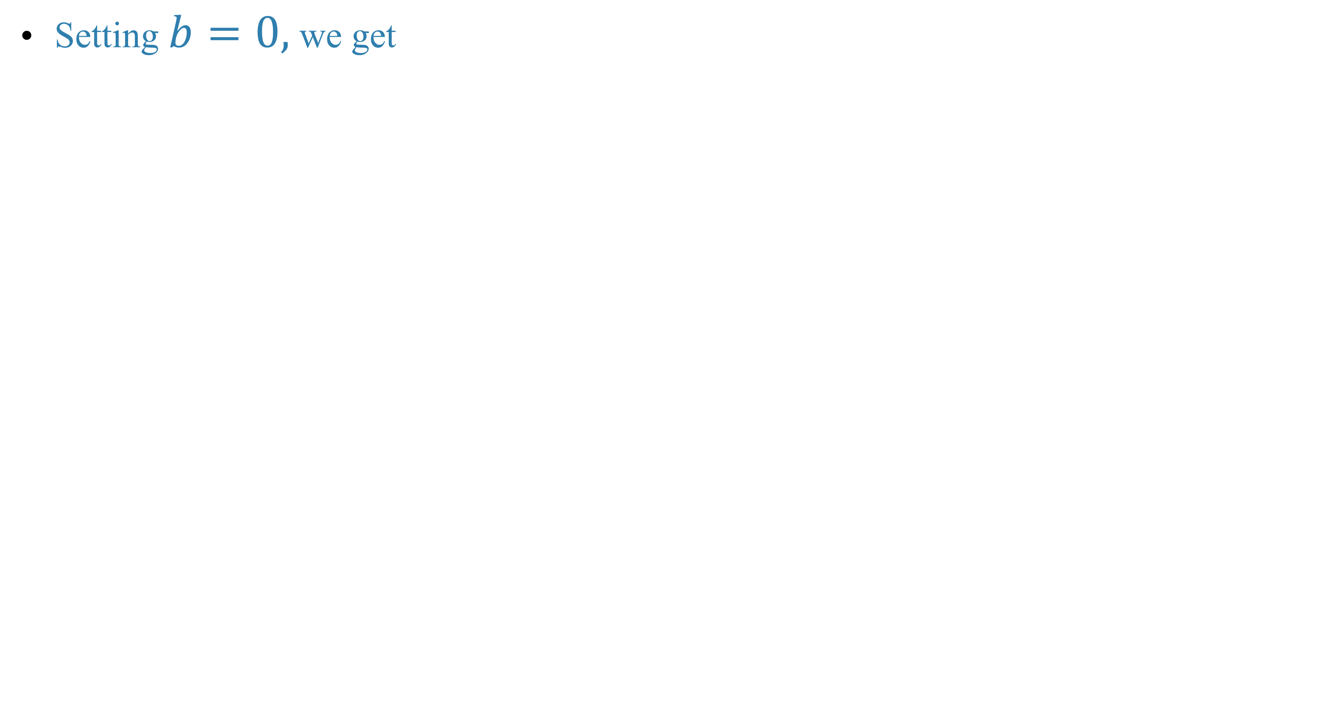
Setting $b=0,$ we get

Slide 16
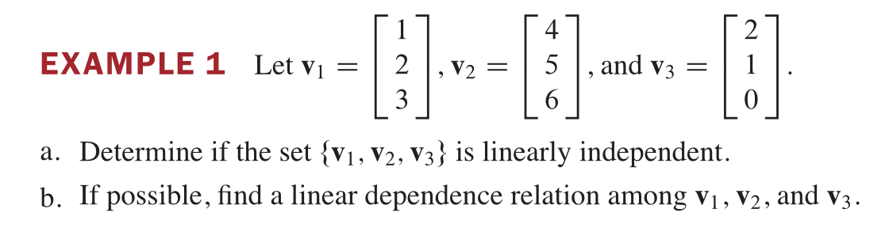

Slide 18
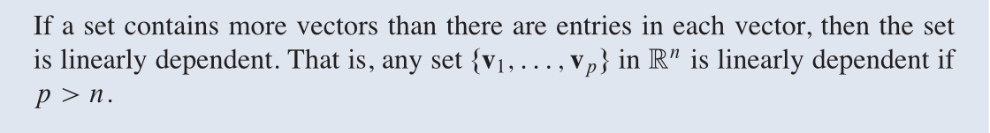
Theorem

Slide 19
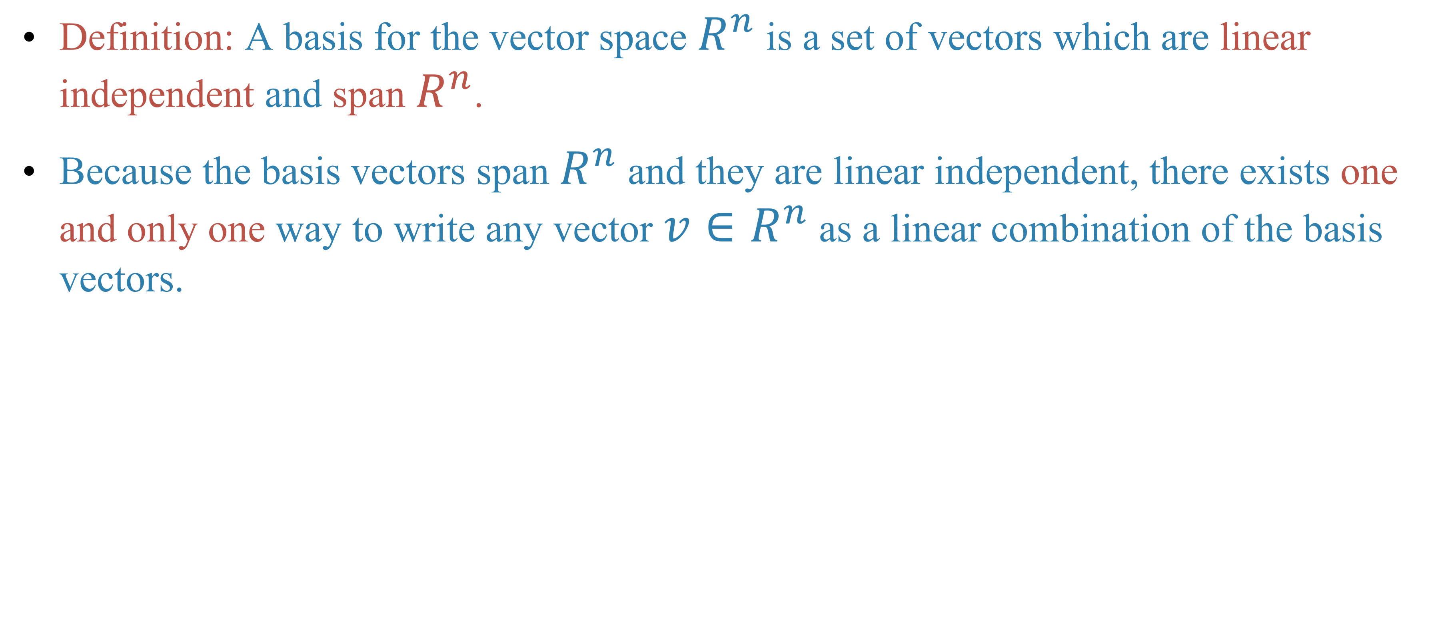
Linear independence, basis and dimension
Definition: A basis for the vector space $R^{n}$ is a set of vectors which are linear independent and span $R^{n}$.
Because the basis vectors span $R^{n}$ and they are linear independent, there exists one and only one way to write any vector $v∈R^{n}$ as a linear combination of the basis vectors.

Slide 20
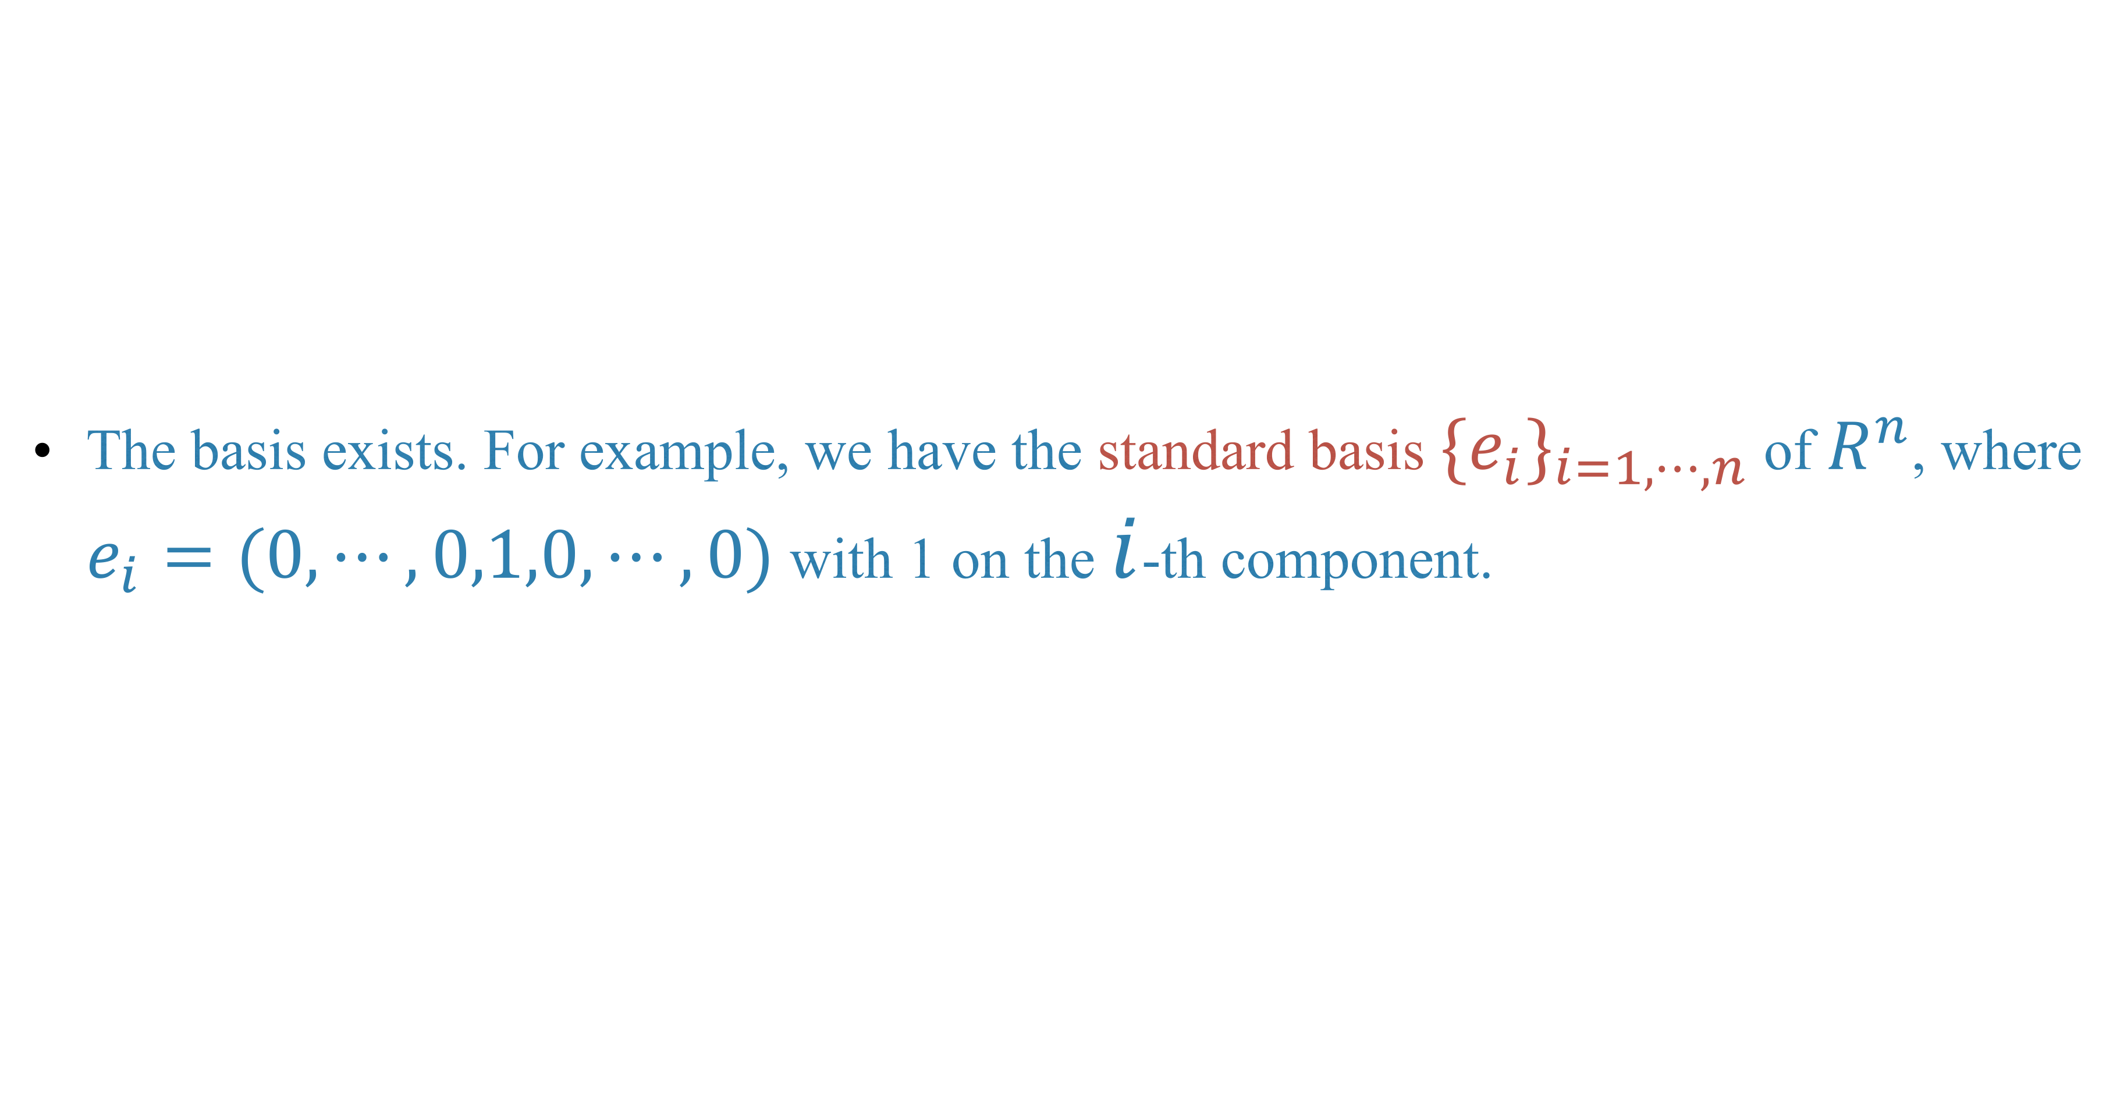
The basis exists. For example, we have the standard basis $\{e_{i}\}_{i=1,⋯,n}$ of $R^{n}$, where $e_{i}=(0,⋯,0,1,0,⋯,0)$ with 1 on the $i$-th component.

Slide 21
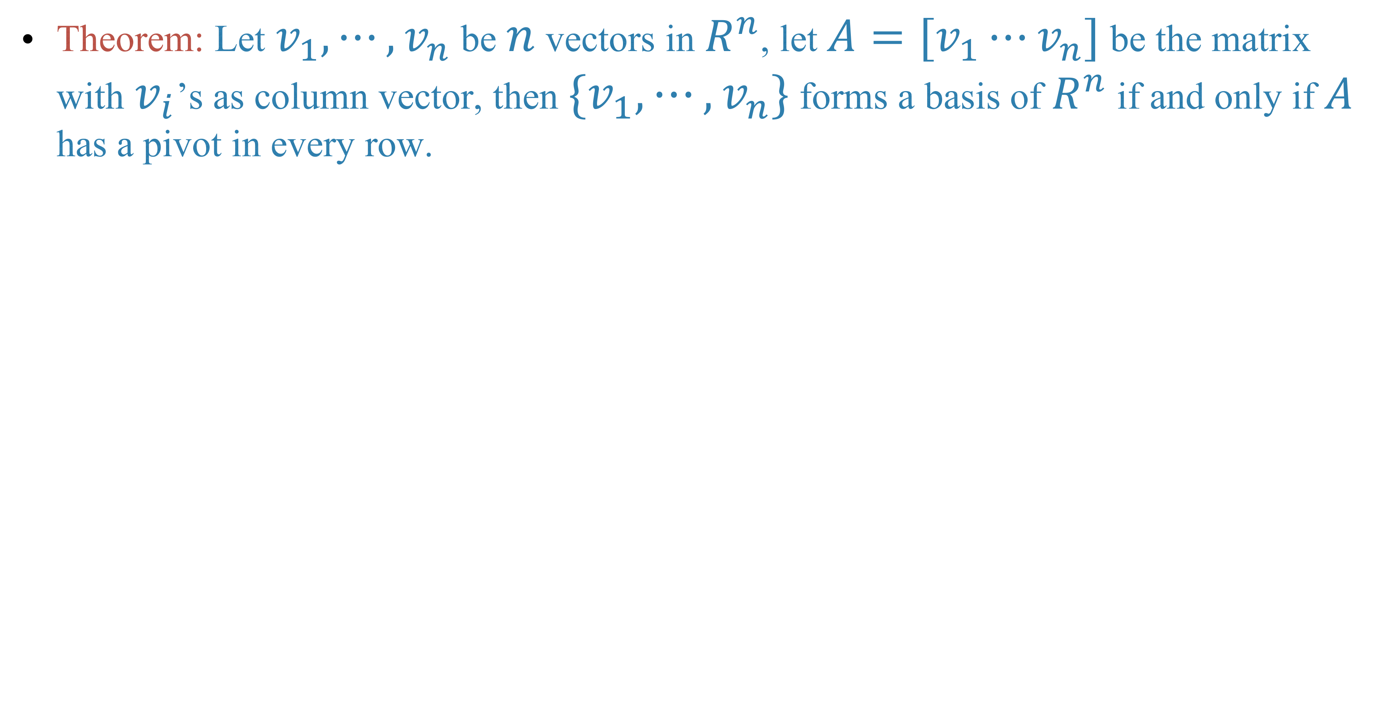
Theorem: Let $v_{1},⋯,v_{n}$ be $n$ vectors in $R^{n}$, let $A=[v_{1}⋯v_{n}]$ be the matrix with $v_{i}$’s as column vector, then $\{v_{1},⋯,v_{n}\}$ forms a basis of $R^{n}$ if and only if $A$ has a pivot in every row.

Slide 22
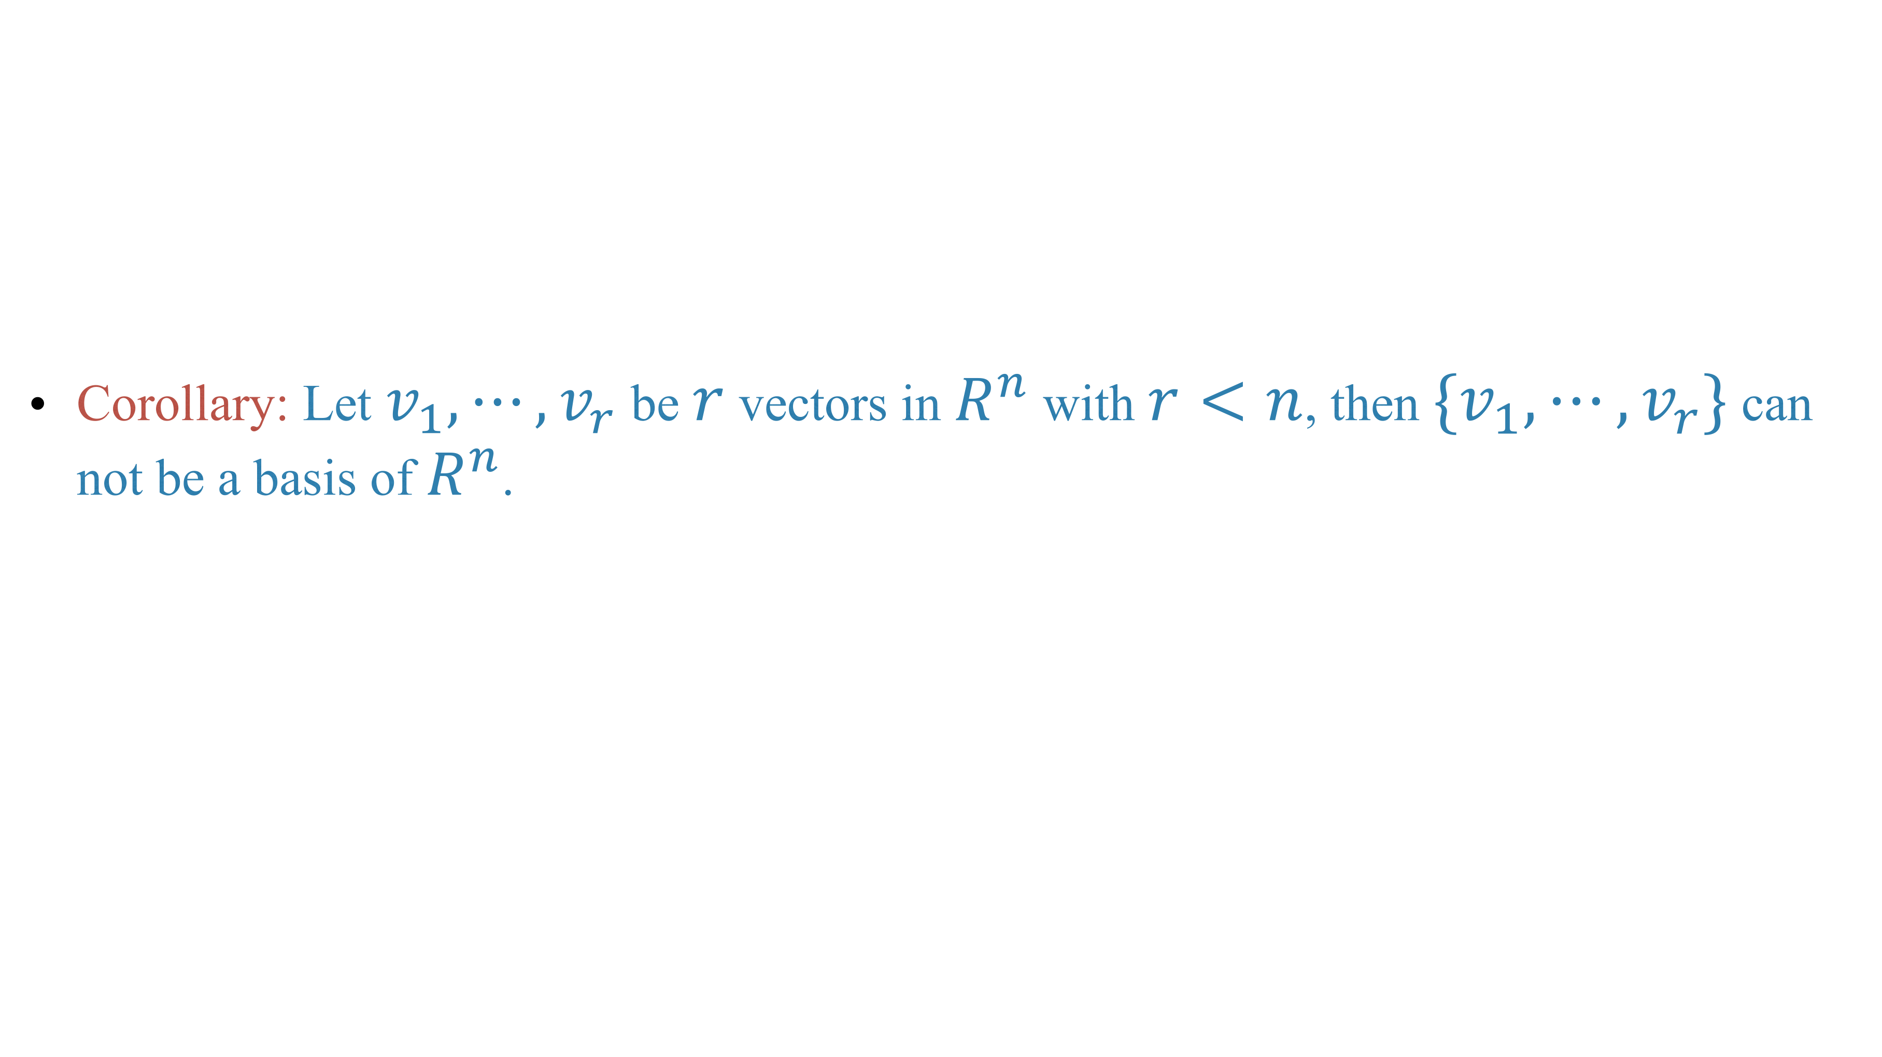
Corollary: Let $v_{1},⋯,v_{r}$ be $r$ vectors in $R^{n}$ with $r<n$, then $\{v_{1},⋯,v_{r}\}$ can not be a basis of $R^{n}$.

Slide 23
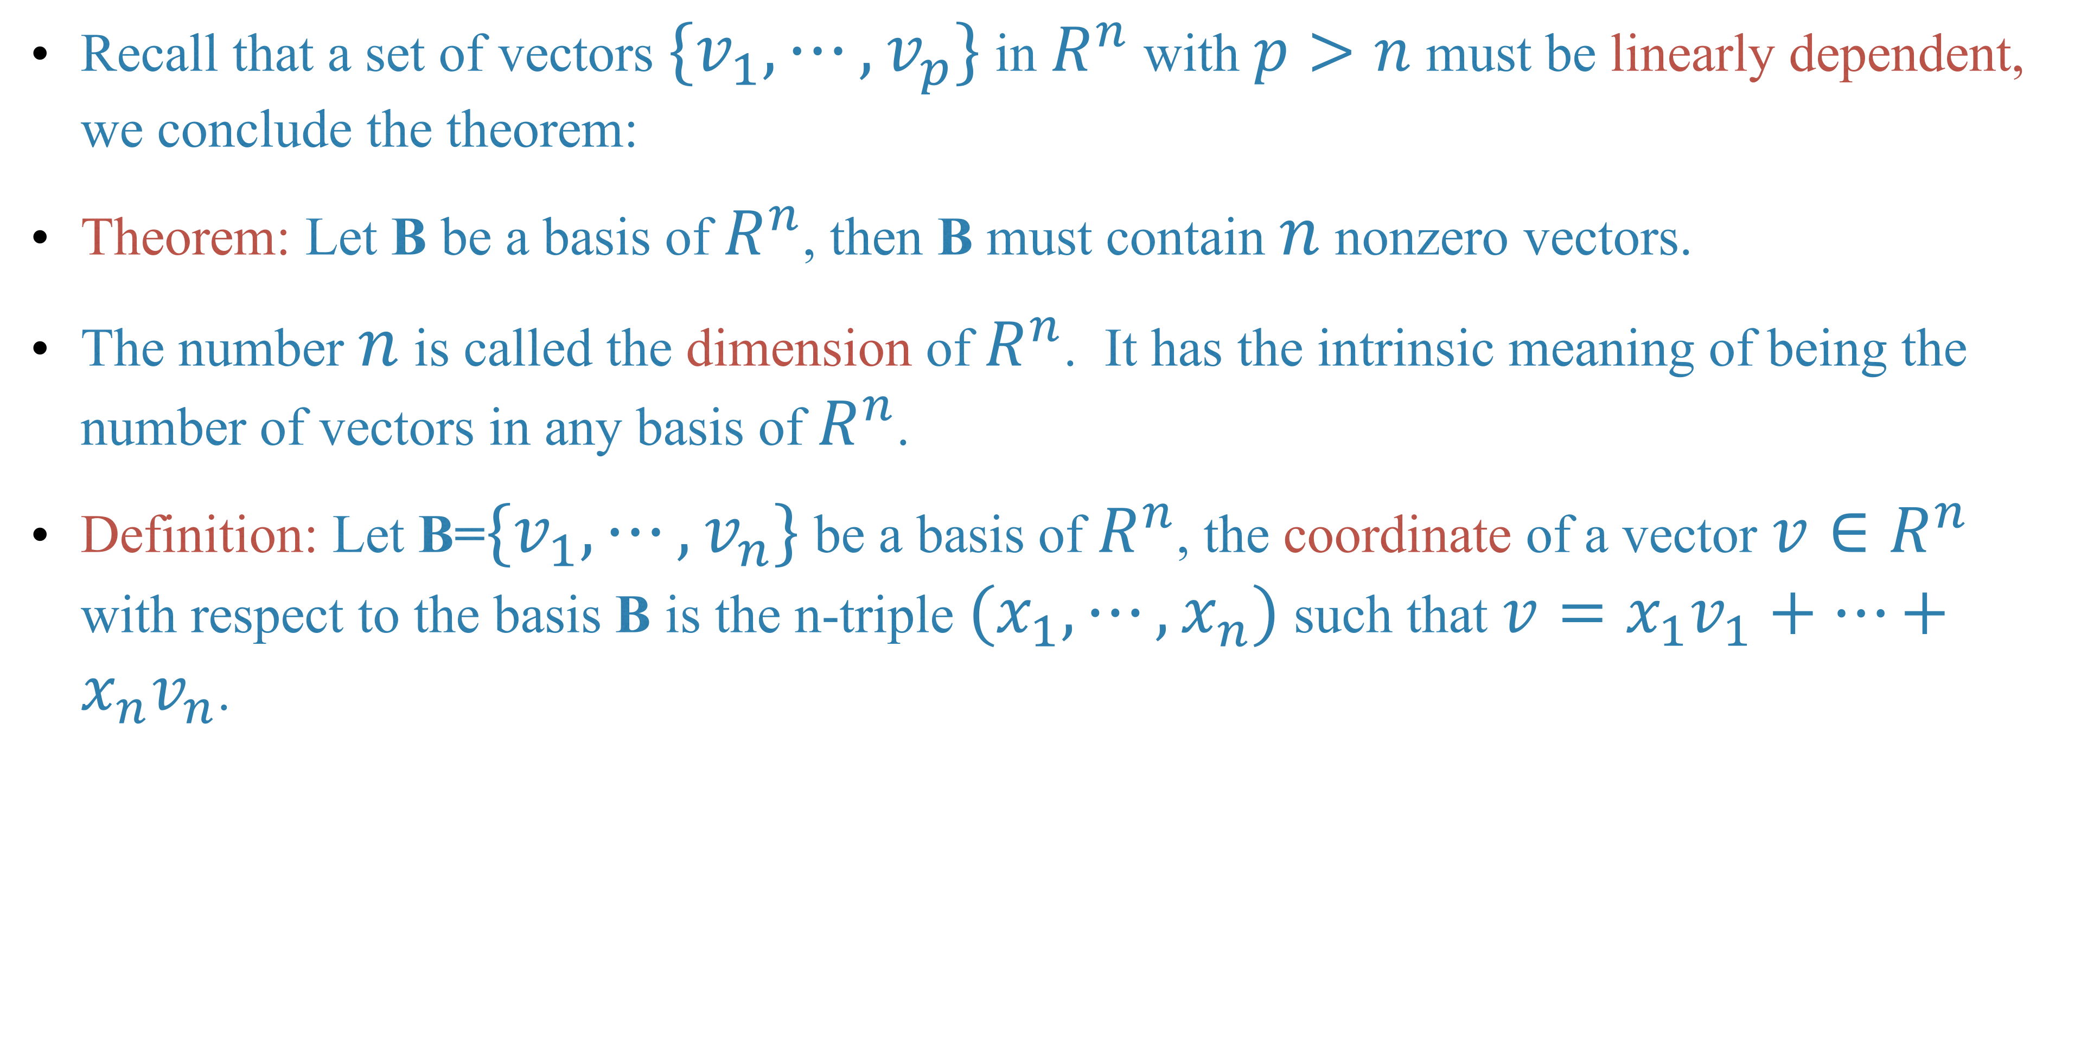
Recall that a set of vectors $\{v_{1},⋯,v_{p}\}$ in $R^{n}$ with $p>n$ must be linearly dependent, we conclude the theorem:
Theorem: Let B be a basis of $R^{n}$, then B must contain $n$ nonzero vectors.
The number $n$ is called the dimension of $R^{n}$. It has the intrinsic meaning of being the number of vectors in any basis of $R^{n}$.
Definition: Let B=$\{v_{1},⋯,v_{n}\}$ be a basis of $R^{n}$, the coordinate of a vector $v∈R^{n}$ with respect to the basis B is the n-triple $(x_{1},⋯,x_{n})$ such that $v=x_{1}v_{1}+⋯+x_{n}v_{n}$.

Slide 24
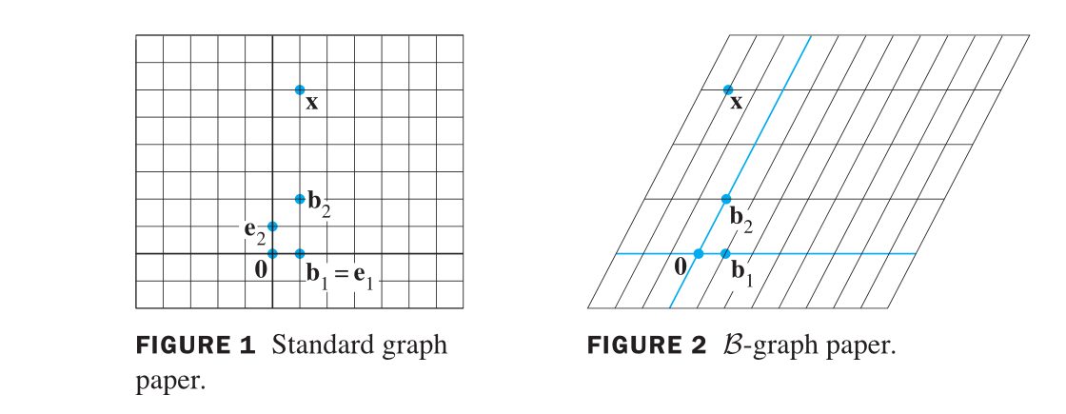
Example of different coordinate system

Slide 25
Homework
Lay-Lay-McDonald, 1.7 Exercises, question 12, 21, 22, 39, 40.

Slide 26
Next time
Lay-Lay-McDonald, chapter 4, 4.1, 4.3

